Slide 1
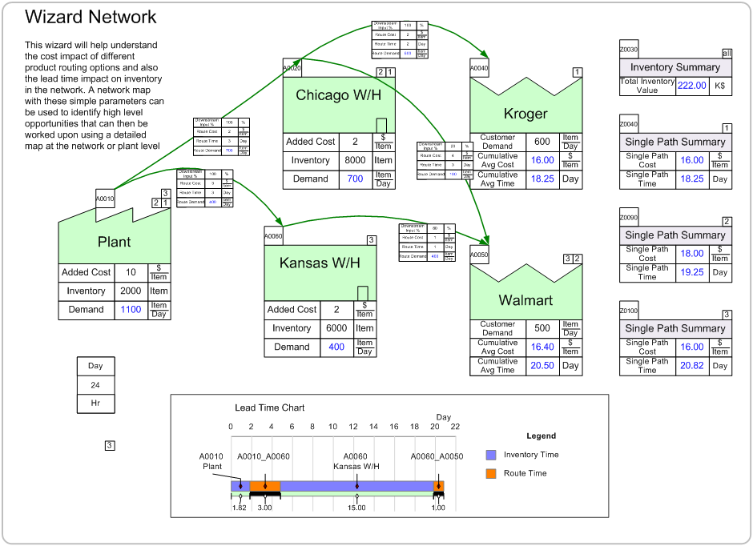
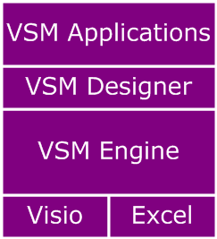
eVSM
electronic Value Stream Mapping
Dilesh Patel
eVSM
dilesh.patel@evsm.com
www.evsm.com
+1 513.378.9701

Slide 2
eVSM Benefits
Integrated Lean Toolkit
  Reduce data transfer
Specialized by VSM Type
Highly visual
Highly automated
Standardized

Slide 3

Value Stream Mapping
(VSM)
3

Slide 4
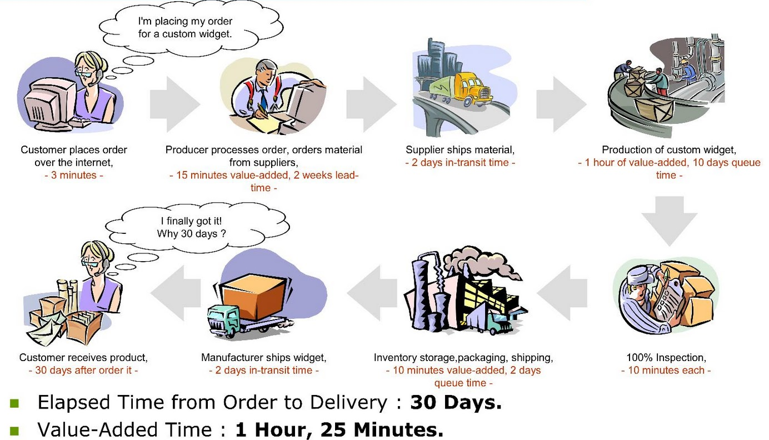
Value Stream Map

Slide 5
Lean Principles
-”Lean Thinking” by Womack & Jones
Define value from customers perspective
Map the value stream
Create flow & eliminate waste
Create pull where flow is difficult
Seek perfection
Minimize the LEAD TIME
Adequate & Efficient CAPACITY
Minimum COST for QUALITY

Slide 6

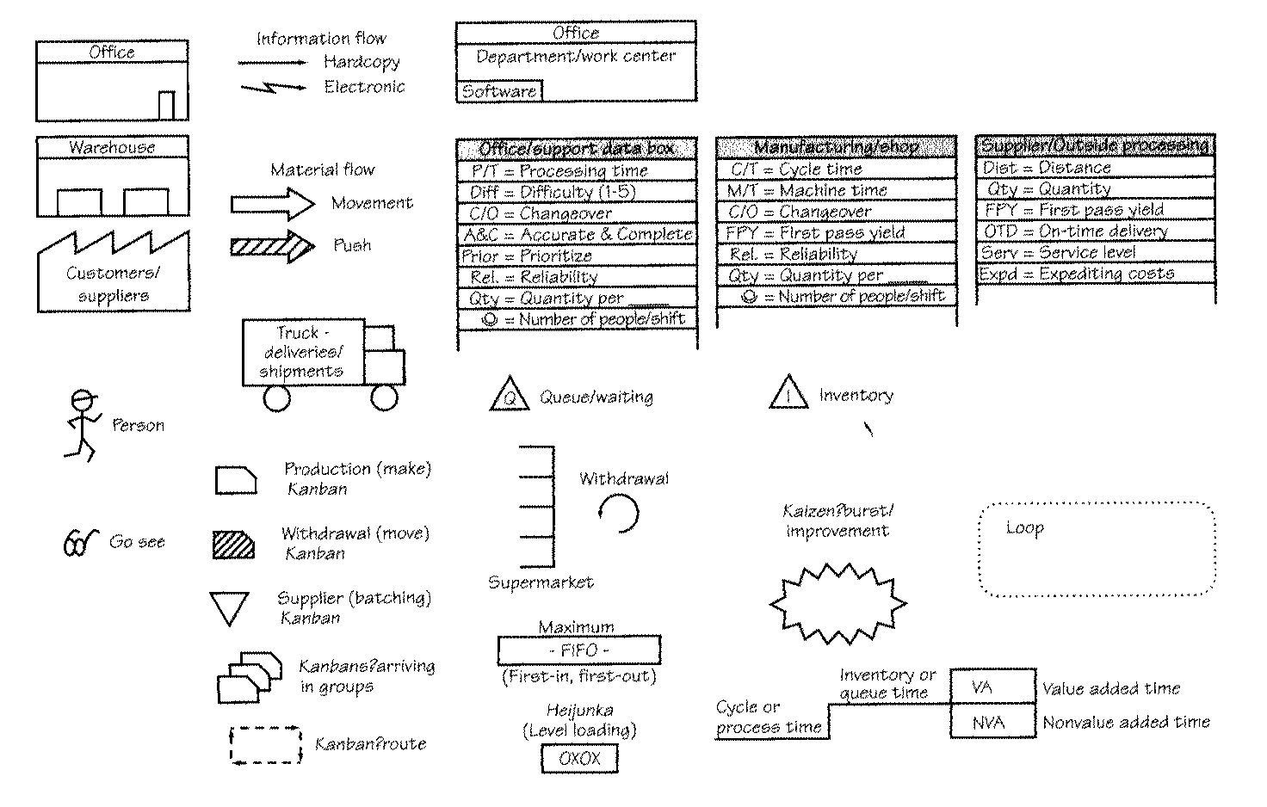
VSM - Learning To See

Slide 7
What’s a Value Stream Map?

Slide 8
Types of Waste

Slide 9
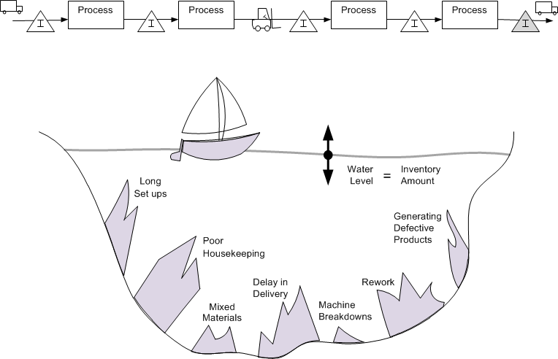
Hiding the Waste

Slide 10
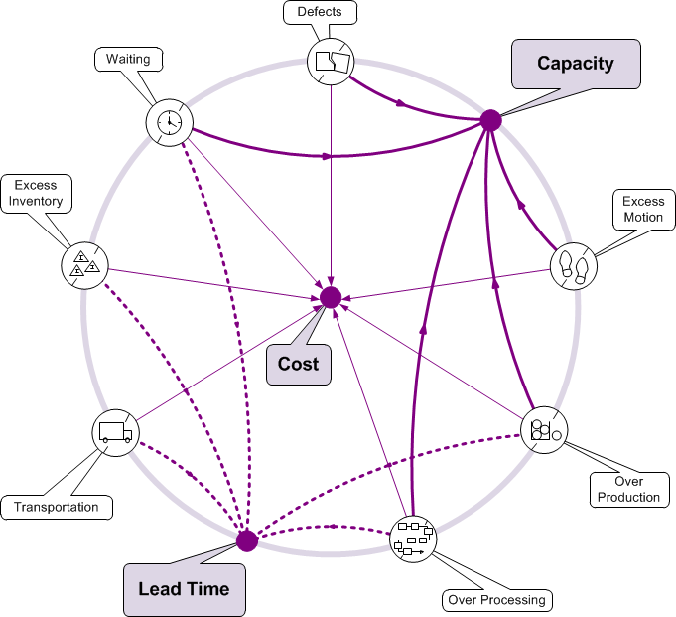
Lead Time, Capacity, Cost

Slide 11
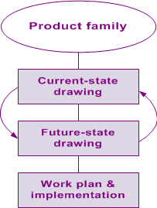
Continuous Improvement

Slide 12
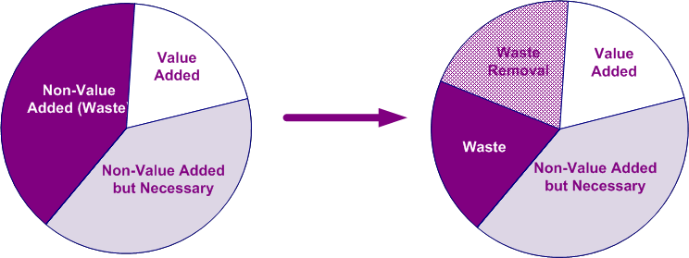
Waste Removal

Slide 13
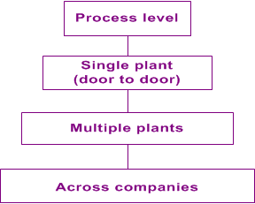
Map Focus

Slide 14

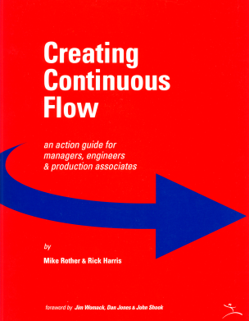

Lean / Value Stream Types
Process Level
Plant Level
Office
Services
Materials
Multiple Plants
Across Companies

Slide 15
Why Value Stream Mapping
Lets us visualize the system level
Allows us to see waste sources
Shows linkage between information and material flow
Helps select improvement projects
Provides an implementation blueprint
Helps communicate all of the above

Slide 16
Improvement Cycle
Wall Sketch
Capture Map
Implement Improvements
Analyze & Visualize
Prioritize Improvements
Brainstorm Improvements
Create Future State

Slide 17
Why eVSM?
17

Slide 18
Why eVSM?
VSM is ALL we do
Our solution
  Productive (for Improvement Professionals)
  Standardized for team deployment
  Specialized by Value Stream Type
Lean Enterprise Institute
  Distribution Partner
  Workbook support
Large Community of Users (14,000+)

Slide 19






14,000+ Users of eVSM Today

Slide 20
eVSM Benefits
Lean Practitioner Benefits
Easy
Fast
Focused
OpEx Team Benefits
Standardized
Notes:
This shows a typical value stream map with lead time and capacity charts (cycle time/takt time chart). The visuals for capacity, lead time and cost and the waste contributions within each category, helps the lean practitioner do “what-if” analysis and pick the RIGHT improvements to support the business need.

Slide 21
Visualize Improvements

Slide 22
eVSM Benefit
  “With the use of the eVSM software, my productivity in developing process maps and value stream maps has increased 10x. The ease of use of the software not only saves time, but also embeds standardization across the users of the software (e.g., my staff of engineers)…”
Dave Levine
Executive Vice President
Consulting Services
Techsolve, Inc.
Notes:
eVSM has over 14,000 users in 40+ countries. Here’s some benefits that lean practitioners using the software have cited..

Slide 23
eVSM Group Vision
Advance the science of VSM
  User Forum’s
  Linked-In Community
  Collaboration / OpEx Groups
  Teaching (VSM & eVSM)
  Publications : Book Of Maps

Slide 24
eVSM Architecture
24

Slide 25
eVSM v8 Architecture
Visio + Excel Base
VSM Engine
VSM Designer
VSM Applications

Slide 26
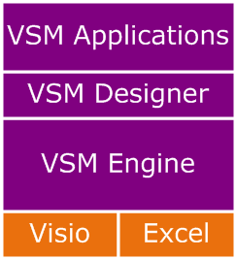
Visio + Excel Base
Drawing + Analysis
Ease of Use drivers
Drag & Drop environment
Bi-directional Integration
Continuous growth

Slide 27

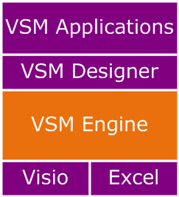



VSM Engine
VSM Shape Library
Variables & Units Manager
Macro Shapes
Equations Manager
Charts

Slide 28
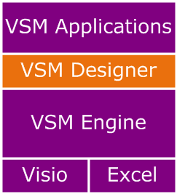
VSM Designer
Rapid application design
  Design sheets
  Lean equations
  Cumulative calculations
  Resource handling
  Map linkages
  Wizards
  Visio / Excel integration
  Multi-path maps

Slide 29
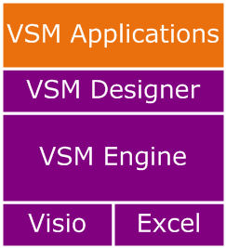
VSM Applications & Wizards
Applications
  Plant level mapping
  Enterprise level mapping
  Transactional mapping
  Healthcare Mapping
Wizards
  Kanban wizard
  Multi-machine wizard
  EPEI wizard
  Shift Patterns

Slide 30
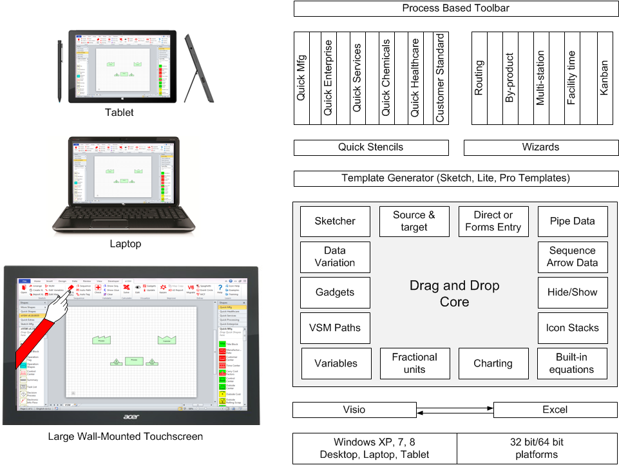
eVSM v8 Platform

Slide 31
eVSM Platform

Slide 32
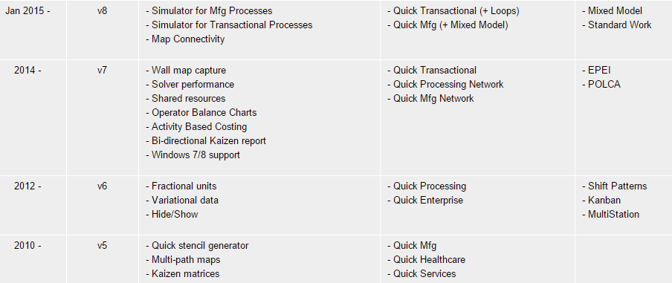
eVSM v8 / Features
Date Version Engine Quick Stencils Wizards

Slide 33
What is a VSM
Application?
33

Slide 34
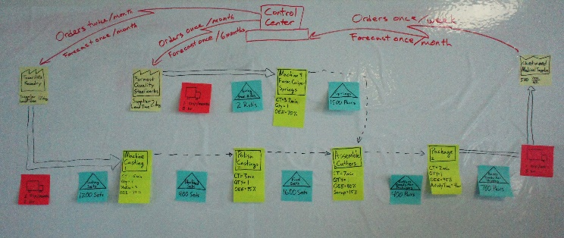
Where does eVSM help ?
Capture the wall map
Analyze the waste
Improve the value stream
Notes:
The wall map is the typical end result of a groups mapping activities.
eVSM makes it easy to capture the wall map, analyze it, and visualize the waste so that the right improvements can be made.
Maps can be shared, managed, and leveraged.

Slide 35
eVSM v8 / VSM Types
Discrete Parts & Assemblies
Chemicals Processing
Food Processing
Enterprise & Supply Chain
Healthcare
Office & Transactional

Slide 36
What’s in each VSM Type
Complete Icon Set
Standard Variables
Built-in Equations
Macro Shapes
Built-in Charts
Notes:
4x mapping speed and quantified improvements for each map type with a well designed set of icons, variables, macro shapes, equations and charts

Slide 37
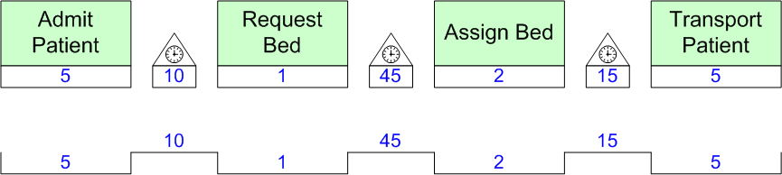
What is a Quick Stencil?
Very fast way to map
Drag, Drop & Enter Values
Automated Calculation & Charts

Slide 38
Automated Calculation
Total Time =VA + NVA
=(5 +1+2+5) + (10+45+15)
=13+70
=83 Min’s

Slide 39
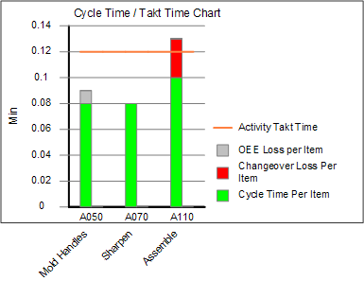
Automated Charts

Slide 40
Map Examples
40

Slide 41
Quick Manufacturing Concepts

Slide 42
Quick Manufacturing Map

Slide 43
Quick Processing Concepts

Slide 44
Quick Processing Map

Slide 45
Quick Enterprise Concepts

Slide 46
Quick Enterprise Map

Slide 47
Quick Transactional Concepts

Slide 48
Quick Transactional Map

Slide 49
Quick Healthcare Concepts

Slide 50
Quick Healthcare Map

Slide 51
Mfg Network Map

Slide 52
Proc Network Map

Slide 53
Wizards
53

Slide 54
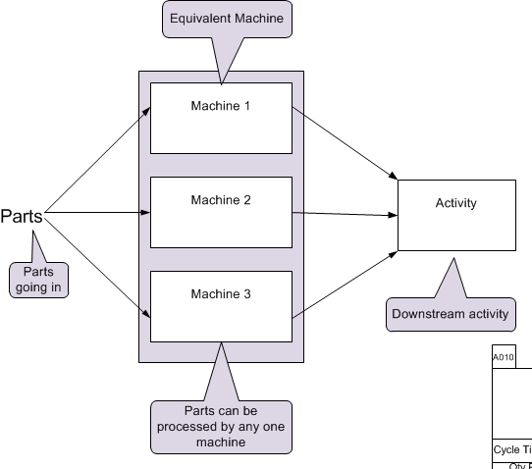
Quick Mfg Multi Station Wizard

Slide 55
Quick Proc Multi Station Wizard

Slide 56
Kanban Wizard

Slide 57
Facility Time Wizard

Slide 58
EPEI Wizard

Slide 59
Spaghetti Diagramming

Slide 60
Training and
Deployment
60

Slide 61
eVSM Software + Services
eVSM Software
  $448 per license
  10% discount (10 or more in one order)
Updates & Support
  Included in license for first year
  $99 per license each following year
Training
  On-Site Training
  Public Workshops

Slide 62
VSM & eVSM Workshop
3 Day Hands-On Workshop
  Covers all VSM Types
    Plant, Network, Transactional
  Teaches VSM & eVSM
    Starting with wall maps
  Supports improvement cycle
    Current state
    Improvement ideas
    Future State(s)
    Implementation Plan

Slide 63
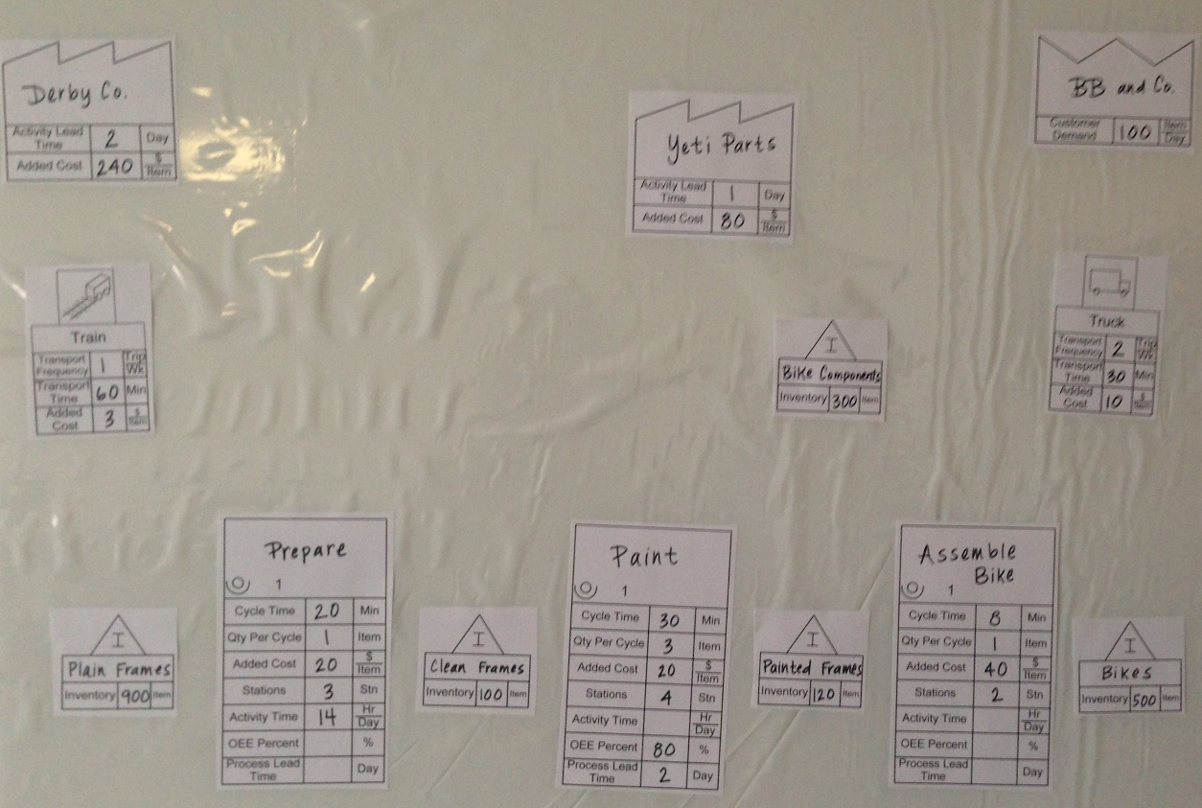
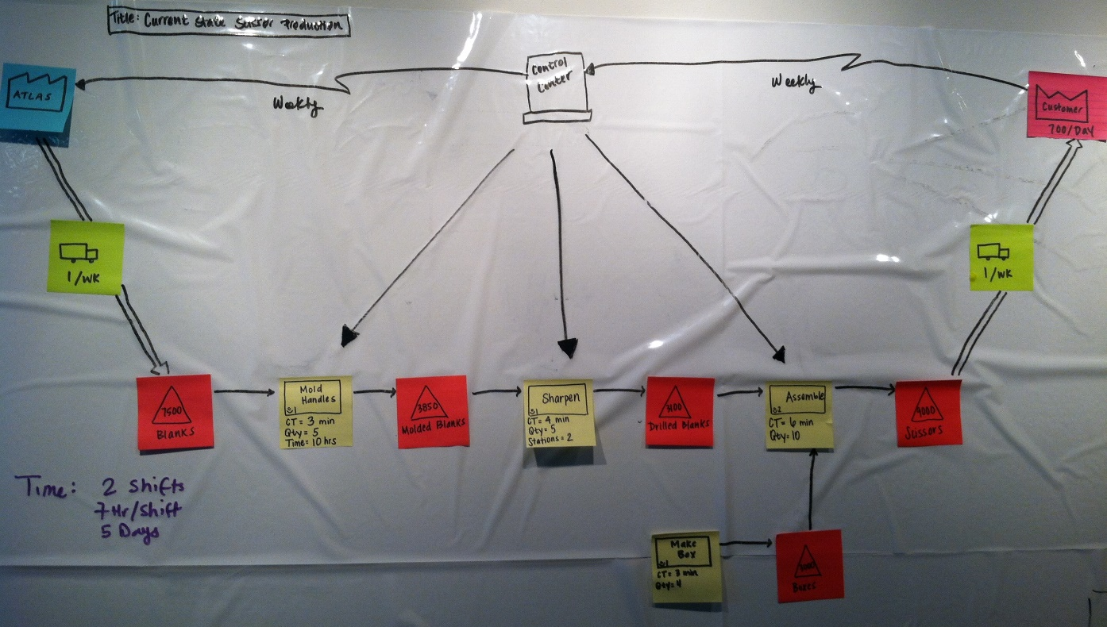
Wall Maps Made Easy

Slide 64
Wall maps into eVSM

Slide 65
Standard Equations & Charts

Slide 66
Equations Export to Excel
Cycle Time Per Item = 'Cycle Time' /('Qty Per Cycle' * 'Stations').

Slide 67
Kaizen Improvements

Slide 68
Stencil specific mapping

Slide 69
Manual Based Training

